Slide 1
Development Testing – Is It Worth It?
Arthur Hicken
September 2012
Notes:
Development Testing: Is it Worth It?
Development Testing is a lot like exercising and eating well: pretty much everyone agrees that it's beneficial and should be done, but few actually achieve it in practice.
A rising number of organizations are flirting with Development Testing by giving developers a static analysis tool and hoping that they use it to prevent defects. This is not unlike packing some raw broccoli and spinach in your son's lunch box and expecting his health to improve as a result. This approach to Development Testing inevitably fails to deliver the results that organizations have been able to achieve with a comprehensive, policy-driven Development Testing process: reduced risks while cutting development time and costs.
If you can't bear the business risk associated with defects surfacing in your organization's software, join our webinar—Development Testing: Is it Worth It?—to learn how to get the maximum risk reduction from your investment in Development Testing. After exploring the dangers of relying on static analysis alone and the top barriers to comprehensive Development Testing, you'll learn how Parasoft's comprehensive Development Testing platform can help you:
- Consistently apply a broad set of complementary Development Testing practices—static analysis, unit testing, peer code review, coverage analysis, runtime error detection, etc.
- Accurately and objectively measure productivity and application quality
- Drive the development process in the context of business expectations—for what needs to be developed as well as how it should be developed
- Gain real-time visibility into how the software is being developed and whether it is satisfying expectations
- Reduce costs and risks across the entire SDLC

Slide 2
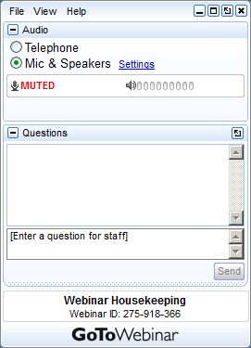
GoToWebinar Housekeeping
Your Participation
Open and hide your control panel
Join audio:
Choose “Mic & Speakers” to use VoIP
Choose “Telephone” and dial using the information provided
Submit questions and comments via the Questions panel
Note: Today’s presentation is being recorded and will be provided within 48 hours.
Notes:
Give Attendees a closer look at the control panel and how they can participate. Text may be adjusted to suit your event needs.
Note: Hand Raising is enabled (see slide 3)
Visit the “Options” menu in the Organizer control panel a check to allow attendees to Raise Hands.

Slide 3
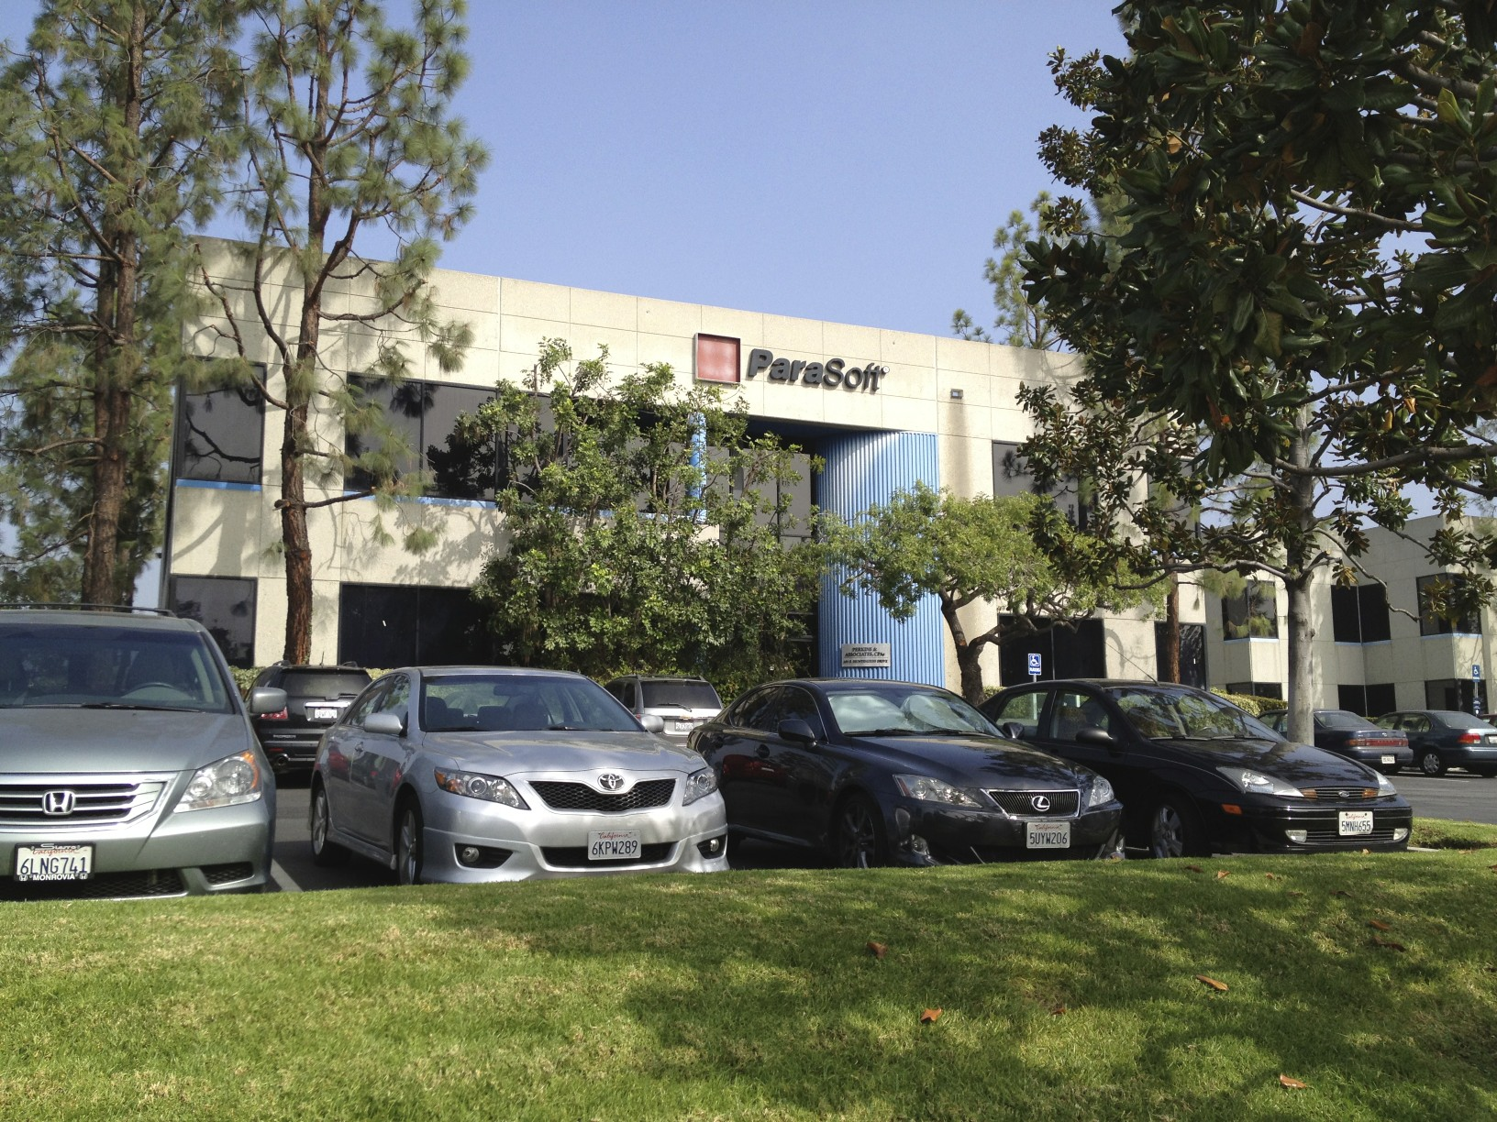
About Parasoft
Founded in 1987
Runtime Error Detection in 1993
Static Analysis tools since in 1994
Automated Test Generation in 1997
Development Testing Platform in 2003
Automated Defect Prevention published 2007
Automated Defect Prevention: Best Practices in Software Management published 2007
27 Patents for automated quality processes
Build quality into the process
Notes:
So really brief, about Parasoft: Parasoft was founded in 1987.
We’ve been building static analysis tools since 1994 so we know a lot of experience and we are quite good at it.
We’ve got 27 patents around various automated quality processes.
Our core focus is looking into development process and find area where we can automate the process to free the human up.
To do in a such clever way to do so, that drive human away from boring work and human can focus and perform more difficult and important tasks.

Slide 4
Parasoft Capabilities
Technologies
Quality Policy Management
Task Management
Code Analysis – Pattern Based
Code Analysis – Flow Based
Code Analysis - Metrics
Code Review
Unit Testing Framework
Memory Error Detection
Runtime Analysis
Message/Protocol Testing
Application Behavior Emulation
Functional Testing
Load Testing
Notes:
This is a list of some of the things we have; policy management static analysis… unit testing and runtime analysis, protocol testing, functional testing etc so…
I’m sure you all know how to access our website so feel free to go there and poke around and if you have any questions, we’ll be happy to answer them
That’s all what I want to explain what Parasoft does. Hopefully that wasn’t too painful for you.

Slide 5
What is Development Testing?
What is it?
Best practices
Processes
Infrastructure
Desktop
Policy and Business needs
What Development Testing is Not
A replacement for QA
Simply a shift of the test process
A silver bullet
Notes:
sa is just one part of dev testing - talk about others we support like peer review, UT, metrics, etc

Slide 6
Aspects of Development Testing
Development Best Practices in place
Requirements
Traceability / Compliance / Audit
Static Analysis
Peer Review
Unit Testing
Source Control Integration
Developer IDE Integration
Automated / Continuous build
Metrics
Workflow
Infrastructure

Slide 7
Isn’t QA Enough?
Development Testing begins where QA Ends
Or vice-versa
Policy driven
Process oriented
Engineering focused
Focus on Prevention
Notes:
fails because of lack of true process approach
promotes process; captures business expectations
problem is two missing components
perspective of process
and joining mgmt expectations to dev

Slide 8
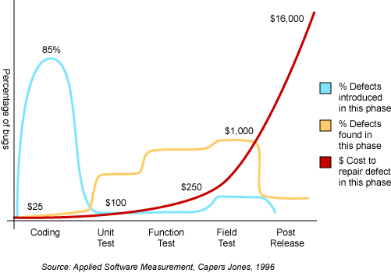
Why Prevention? The Cost of Errors

Slide 9
Why Prevention? The Cost of Errors

Slide 10
An Ounce of Prevention
Early Detection is…
Better than Just Q/A
Detection != Prevention
Feedback loop
Frequent issues from Peer Review
Field reports
QA findings
The misunderstood relationship between flow analysis and pattern-based static analysis
Creating a software environment where bugs cannot survive.

Slide 11
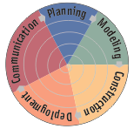
Management and Traceability
Plan and manage your project
fulfill customer requirements
precisely distribute work and resources
predict whether your plan is feasible to meet deadlines
Monitor and manage progress
have instant access to the status and
evidence of risks of current projects
Comply
follow project / organization policies
adhere to best industry practices
fulfill contractual obligations
Certify and Audit
provide traceability to fulfill certification criteria (ISO-x, FDA, DO-178, IEC-x, etc.)
decrease certification cost
support standards like MISRA, JSF, etc.
Improve
optimize products and processes based on historical data (post-mortem analysis)
increase efficiency, performance and utilization
track down where your cost is located

Slide 12
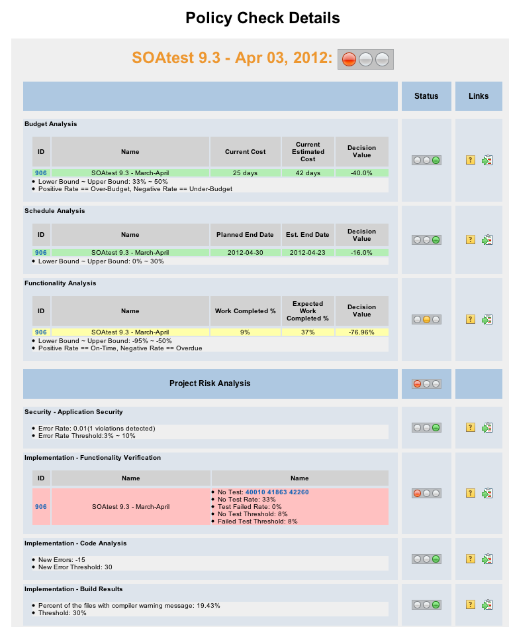
Monitor/Manage Processes: Manager Dashboard

Slide 13
Policy - Is It Working?
Setup policies
Test Coverage
Unit Tests Executed
SA Compliance
Peer review expectations
Measure – Monitor - Improve
Base threshold on current results
Incremental improvement
Notes:
IS IT WORKING?: When do you know that it’s working? Now it’s time to setup your policies. One policy is the coverage from unit testing, called “Test Coverage”. The easy way to setup the policy initially is to run your test suite, see what your current coverage is, and set that as your policy. In other words, if your coverage is 10%, set the limit at 10%. Don’t set it at 50%, because you’ll just end up getting a red light all of the time and it won’t be helpful or meaningful.
What you want to do is use the policy to see what ran and what didn’t run. If coverage drops, it means some of your tests weren’t executed.
Another policy can also be setup for how many UT test cases were run or didn’t run. This is called “Unit Tests Executed” and it has settings for how many tests got run, as well as the ratio of failed to successful tests, meaning how many tests had assertion failure. The failure ratio should probably be set to about 10% initially. Having 10% failing is usually not a big problem when you have a sizeable test suite.

Slide 14
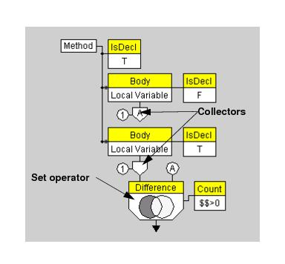
Static Analysis
Variety of methods
Peer Review / Manual Code Review / Code Inspection
Pattern-based code scanners
Flow-based code scanners
Metrics-based code scanners
Compiler / build output
Notes:
Definition of Static code analysis is the analysis of computer software that is performed without actually executing the software being tested.
We’re going to talk briefly about each of these techniques, when/where to use it, and why it’s helpful.
So coming into this presentation we’ve been getting a lot of questions and it seems that static analysis means different things to different people.
Static analysis can be one of those things in the list here:

Slide 15
SA for Process Improvement
Flow rules have corresponding pattern-based rules
Prevent the potential rather than chase paths
Analyze issues and select SA based on real problems
Analyze flow-analysis issues and select pattern rules to prevent
Notes:
Process improvement.
If I use my tainted data example.
A program that tries to do error injection or penetration testing;
it’s going to essentially start throwing data at input fields in an application and trying to drive through to where it gets something back
or somehow causes a crash.
The problem is that any real application has a near infinite number of possible paths through the application.
If I can instead consider that if I always validate inputs, that I can make sure that these kind of paths don’t occur.
Here’s the interesting thing.
If you do this and take real problems, find a flow analysis that helps you find the low hanging fruit,
and you find a rule or set of rules that helps you deal with those in the future for whole team.
It really makes them go away.
If you take all actions that to prevent injection error happening by setting up policy like “all input should be wrapped around inside of validation method before get used”
If you follow this policy religiously and to make sure everyone follows it, flow analysis won’t find any violations about injection.
This is what we called “PROACTIVE” approach to prevent the error from occurring.
And this is the really cool thing.
For example, memory leaks.
We had a customer many years ago who had a cross platform application that was a server application that ran on some 30 different operating systems.
Now understand that the potential for memory problems in 30 operating systems is monstrous.
Now they wrote their own library to use, and this was a C application, instead of “malloc” for memory management.
And this made sure that they had consistent memory management across all of the applications.
That they had garbage collection, essentially, in C.
That they wouldn’t get memory leaks, they wouldn’t get resource hogs that they always knew what was going on.
The memory was also allocated in big fast chunks for performance reasons.
So they literally wrote a static analysis pattern rule to improve their process that said: “You can’t use malloc” and flagged “malloc” as an error.
Now, most of us wouldn’t call malloc an error, but this is a part of process improvement.
Look for the problems that you are finding in the fields, look for the issues that you are seeing in code review.
Look for the things found in QA.
And ask yourself; not just “could I have found this”, but “could I write my code in a completely different way so that this thing could never occur?”
Now this may not be the cheapest option, if the issue is really important to you, this is the best way to do it.
There is really big bang for your buck with static analysis.
So that’s really the most important part of the process improvement.
What people often skip is: post release, look at your rule set and find out what new additional rules you need to add;
look at rules that are noisy and decide whether or not to turn them off so the developers don’t waste time on them.
This really closes the loop at the end of the release so that you can continue to improve your process.

Slide 16
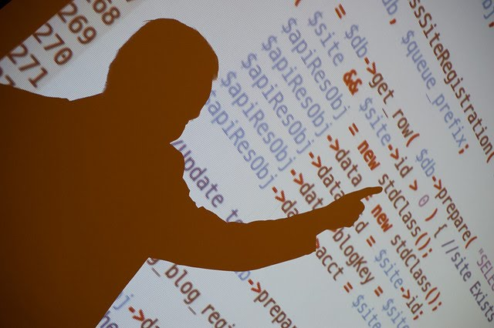
Peer Review
Great for mentoring
Great for conceptual work
Avoid formatting & other things the computer can do
Notes:
What we would call peer review or code review or manual code review or code inspection.
The idea is that humans are looking over each other’s shoulders, the idea being to check to see if the code is doing what you are trying to do. And there’s some really cool stuff out there.
Types range from Developers in a room to Chain letter to IDE supported
The important thing is the CR is great for mentoring, whether it’s an inexperience developer or a new person to the team.
CR is really good at dealing with conceptual issues, like “should I have done this in this way?” What you want to avoid wasting time on
Are things that pattern-based SA tools can catch, like formatting, naming conventions etc.
For example, in security you would code review the actual input validation method to see if it catches everything everyone can think of,
But you wouldn’t waste time checking if input method are named properly, an automated tool should have already done that before the review.

Slide 17
Metrics
KLOC
Complexity
Maintainability Index
Numbers (files, lines, methods)
Notes:
Perhaps the oldest version of static analysis is Metrics-based code scanners where we look at things like complexity or even simply number of lines or methods in a file.
Some times when they people talk about metrics, they mean KLOC, or cyclic complexity, number of methods or classes thing like that.

Slide 18
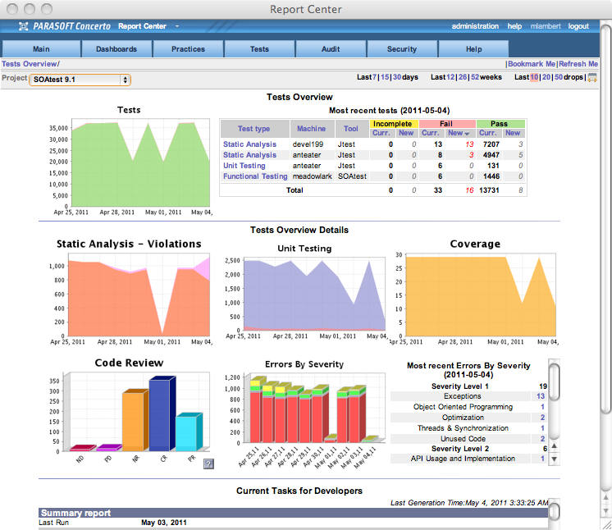
Monitor/Manage Processes: Tests Overview

Slide 19
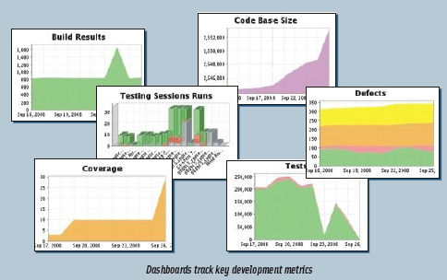
Trend Reporting
Reports should show violations
Show trends
Breakdowns
File
Violation type
Severity
developer

Slide 20
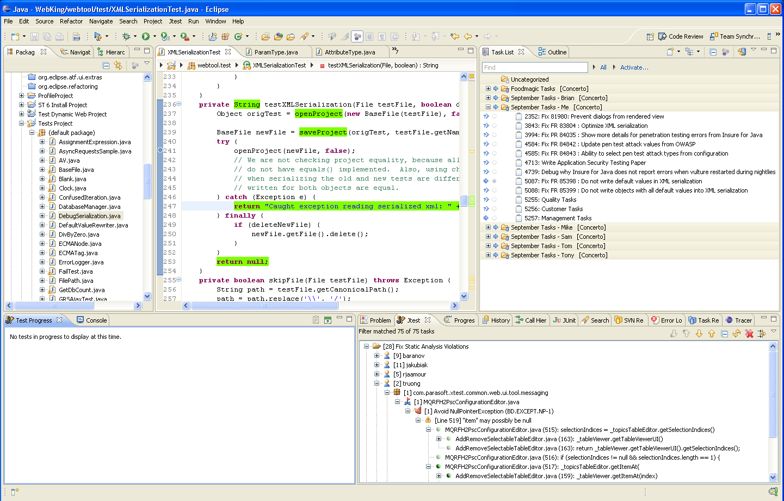
Results within IDE
2
Directly access line of code to fix
3
Check-in
1
Results delivered as uniform view within IDE
Notes:
Want to give you example in IDE, you probably have seen this before. This is Eclipse. If you use NetBeans or Visual Studio. It looks very similar like this anyway. On left, I have list of files and project and the middle I have code etc…
On bottom, I have a view that lists all my static analysis violations from tool. I can really click on to find out what the violations are. At the right, I have a window with my list of tasks that I’m supposedly working on.
My results deliver like anything I do inside of my IDE. I don’t have to learn anything special to use it or dealing with separate tools.
I’ve seen some extreme company doing developing code in one tool, build the code from another tool and accessing source control from another tool and run static analysis from other tool…
Actually have to gather up all data and put into another graphical tool. Guess what? It takes tons of time. It may look like very mature process but it could cost a lot on production.
Single uniform IDE will give you develop, build, test, review all in one place would give much simplicity and keep developers in focus for their tasks.
From IDE, you can easily access violations with file and line number and open up the line to review and quickly fix and check in to source control to update.

Slide 21
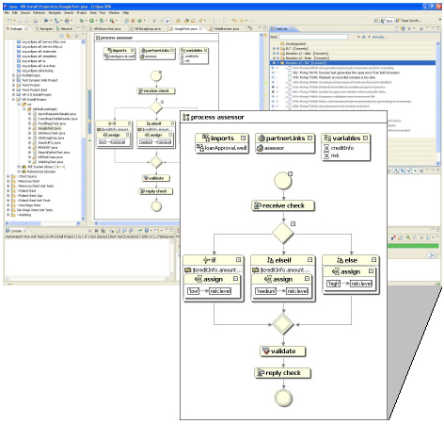
Workflow
Plan processes
Audit trail
Ingrain expected
behavior

Slide 22
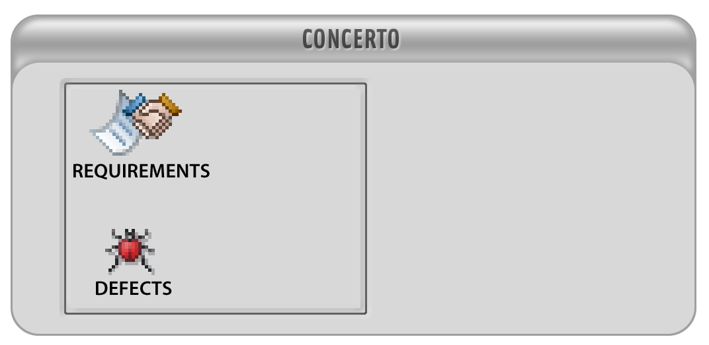
Sample SDLC & Integration
RMS/BTS/SCM integrated – easy collaboration
Task Management System – all activities in one common list of tasks
Automated and Manual Tests, Automated Code Review
Traceability from Requirements, Defects, Tasks to Tests and Source and Code Review
Automated Notification
Prioritized tests based on changes
Extensive reports for CIO, Stake Holders, Project Managers
CIO
PROJECT
MANAGER
MS
PROJECT
REQ
ANALYST
RMS
DEVELOPERS
QA
TEAM
BTS
AUTOMATIC
TEST
SERVERS
DEVELOPERS
SOURCE
CODE

Slide 23
Should I Care about Development Testing?
Why pay attention today?
Moving goal posts
Agile development
Ad-hoc tool usage will not get the job done

Slide 24
Q&A / Further Reading
Automated Defect Prevention
(Huizinga & Kolawa) …Principles and processes to improve the software development process.
Effective C++ / More Effective C++ (Meyers) …Definitive work on proper C++ design and programming.
Effective Java (Bloch) …Best-practice solutions for programming challenges.
Design Patterns (Gamma, Helm, Johnson, Vlissides) …Timeless and elegant solutions to common problems.
info@parasoft.com webinar@parasoft.com

