Slide 1
Migrating Applications to the Cloud Prevent the Most Common Reasons for Failure
Parasoft
December 2012
Notes:
Focused on your internal applications and what can we do to prevent common failures

Slide 2
Poll
Which statement best describes your organization’s cloud migration status of internal applications
Researching and planning
We have rogue applications provisioned to the cloud
Preparing for selective migration
We have formally provisioned applications to the cloud
Notes:
A 62%
B 19%
C 27%
D 23%
Must have been multple choice

Slide 3
Cloud “Migration”…What we see
Stage | Characterized | Summary
Rogue | Experimentation | Against or before an internal mandate Pure simplicity versus internal processes Cool factor
Ad Hoc | Fun with Virtualization | Leverage server virtualization in cloud Only increases risk (and cost) due to duplication
Trial and Error | Business Interest | Opportunity to deliver business value In “Cloud we Trust…”
Responsibility | Service Level Agreement | Architecture analyzed Business penalties palpable Real refactoring / redesign starts

Slide 4
Major Cloud Application Considerations
Infrastructure
Architecture
Monitoring
Security
Instrumentation
Automation
Latency
Parallel
Event-Driven
Fault Tolerance
Resource Consumption

Slide 5
Where To Start
Create your policy
Determine your basic desired architecture
Align with a service provider that meets your business needs and realize that this will be a give and take
Don’t remodel - rebuild
Notes:
Intro – I’m that rogue guy, so I was glad to see Wayne say that rogues are “cool”
You need to have your basic policies fleshed out before you go finding providers and building things. Policies should include things like security, SLA, etc. And then you need to determine at least at a high level how you want it to be architected. Will you use specific libraries and technologies? Are there certain capabilities such as bursting that you need?
All of this will guide your choice of providers, so you don’t need specific low-level details, but if for example you’re going to need elasticity, then a provider that charges a flat rate is probably not going to meet your needs. And you need to know whether you’ll be going private cloud, public, or some kind of hybrid usage.
As you’re doing this, there will be a certain temptation to take the easy way out and just push the stack you’re using into the cloud. While this is certainly a simple way to launch, it is unlikely to give the greater benefits of moving to the cloud like scalability, fault-tolerance, etc.

Slide 6
The old into the new
Notes:
So let’s look at some of the basic things you can do to make the migration easier and increase your chances of success. This box represents my traditional application that I want to move to the cloud. At the top it’s doing a bunch of UI stuff that’s using traditional libraries like .NET, Swing, Cocoa, etc. Hopefully it’s been built so that the UI isn’t deeply intertwined, because guess what – the UI is no longer the center of the world in the cloud, the service is.
So think about what your application is actually doing, and break it down into discrete basic components. Does it access a database, do some kind of computation, connect to some legacy system. The UI will be replaced with new ones that are built on your cloud services using things like HTML or native apps.
Having these components you can plan which parts move to the cloud, in what order, and which stay in-house as needed. Being well defined will make them much easier to build upon, reuse, test and secure, so you’ll be getting big benefits here, especially as you start to expand the system past the first release.

Slide 7
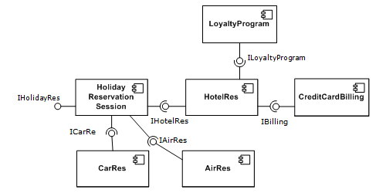
Break it down
Plan out your components
Select the pieces to be reworked and peer-review the plan
Well designed components use API only
Public member fields are a no-no
Notes:
As you’re planning out your components we can start to make good use of some development testing practices. Once you’ve got the basic design, put it through code review. Getting more people looking at the design before it’s set in stone will catch potential problems down the road.
To help make sure that your components are being built properly, and not getting turned into spaghetti, you’ll want to make sure that access to any particular code is through the API only. You can easily check and enforce this using pattern-based static analysis. For example, setup a configuration that will flag all public member fields, and require getter/setters instead. The same can also be said for static methods inside dynamic objects, they’re often a clue that the code is being accessed in a funny way, so use static analysis to catch them early while they’re easy to unravel.

Slide 8
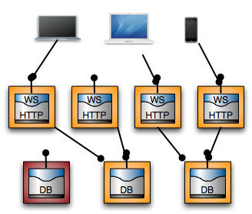
Architectures Tips & Tricks
You want to be:
Parallelizable
Fault tolerant
Resource independent
Notes:
Some of the things to think about while you’re building is making sure of not just the individual components, but how the overall picture fits together. A great reason to go to the cloud is to be scalable, so you’ll want to make sure that your pieces are parallelizable. If you have some component that won’t allow two instances of itself to run at the same time, you’re never going to get the results you want.
And you need to remove yourself from thinking about the hardware. The system is really virtual, and pieces of it may come into existence briefly for your use, then be torn down. Sometimes this will fail, and you need to be able to gracefully not only survive such failures, but find alternates and get the job done. Your solution cannot be bound to a single machine that happens to have a particular resource, such as a database, it needs to be abstracted.

Slide 9
Don’t Run in Circles
Notes:
As software is built in a traditional application over time, it’s uncomfortably natural to end up with a bunch of utility components that have interlocking dependencies. This is a nightmare for maintainability, testing, security, and just about anything else you can think of. You’ll want to make sure as you rebuild that you stay unencumbered. A great way to do this is to use static analysis to check a few things. For example, cyclical or circular dependencies can be detected and corrected.
Take a look at metrics if you’re not already, and see which items will help you. Then make sure to not just run them as a report, but integrated into your development process, so that violations get reported as tasks directly to the developers, through the IDE, bug-tracking system, etc.

Slide 10
No Monoliths in the Cloud
Giant Files
Giant Functions
Notes:
You’ve all seen 2001. While the monolith is cool and can do amazing things, who really knows that it’s actual functionality is? Can you imagine trying to run penetration testing on it to be sure it’s secure? You’ll want to avoid such things. And monolithsm isn’t just represented by being a single binary, it also expresses itself in other ways, such as giant files or giant functions.
Again, static analysis can be used to help. Turn on metrics that flag files over a certain size, maybe a couple of hundred lines or whatever you’re comfortable with. I’ve seen applications that have a single file with 50,000 lines of code. Who thinks that was well built?
Do the same for methods or functions. If a function has too much code in it, it’s a warning that it might not be well-defined or built, for example it’s possibly doing two different things rather than one. So check the size of individual units inside the file using static analysis as well.
There is another great way to find monolithic code, and that’s coverage analysis.
Poor coverage can point to monolithic code. If you don’t have any coverage information, tools that do auto-generation for unit testing also work especially well in this regard. If they can’t generate good coverage, it’s an indicator that something is going on inside the method unrelated to the parameters being passed to it. So you can clean it up.

Slide 11
Thinking Globally
Notes:
The phrase “think global act local” is not usually applied to software, but it can be relevant. The point being that you should avoid global variables in your code. After all, what is “global” in a service oriented context? Once you’re using components, the use of globals becomes cumbersome and even dangerous, so keep your information local.
Use static analysis to pin-point and remove global variables.

Slide 12
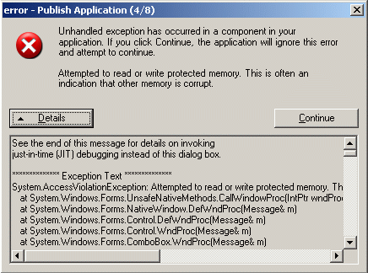
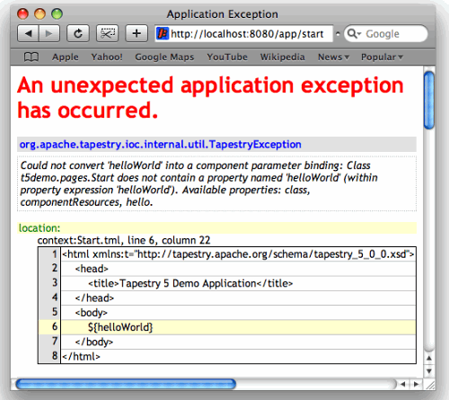
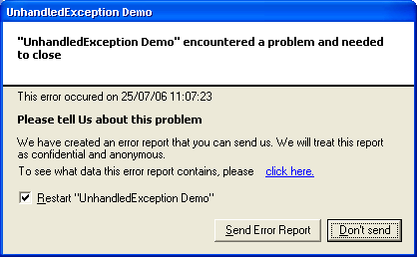
Be Exceptional
Notes:
Being exceptional is normally something to strive for, but not in software. Uncaught exceptions are more troublesome in a cloud infrastructure. Your typical scenario for an unhandled exception is that it ends up going all the way up to the application server, and you get some strange incomprehensible error message that is useful to neither the user nor the developer.
Look out for runtime exceptions, the compiler usually doesn’t check.
Null pointers can wreak havoc – a classic case of system instability. It can turn into kind of a death spiral -
What to do:
Static for unhandled exceptions and nulls
Auto-generation for nulls and unhandled runtime exceptions

Slide 13
Security is vital
Suddenly there are openings everywhere
Can’t rely on “it was checked elsewhere in the application”
Input validation covers wide swath of potential problems
OWASP Top 10
CWE Top 25
Notes:
Security is obviously something you need to pay attention to. In the past you might have been concerned only with services that were outward facing, now you need to make sure that every piece works as if it is alone – in essence no one can be trusted. Validate input, authenticate usage, harden ports, suppress data leakage, encrypt data, all the classics.
From an attack surface perspective you can think of it like being one surface per component. Scary, isn’t it?
You can’t rely on something else having taken care of it for you already. Even if you currently plan it that way, future usage or unexpected usage may end up bypassing your security mechanisms, so make sure you cover everything.
There is some great information from OWASP and CWE that can give you a solid foundation.

Slide 14
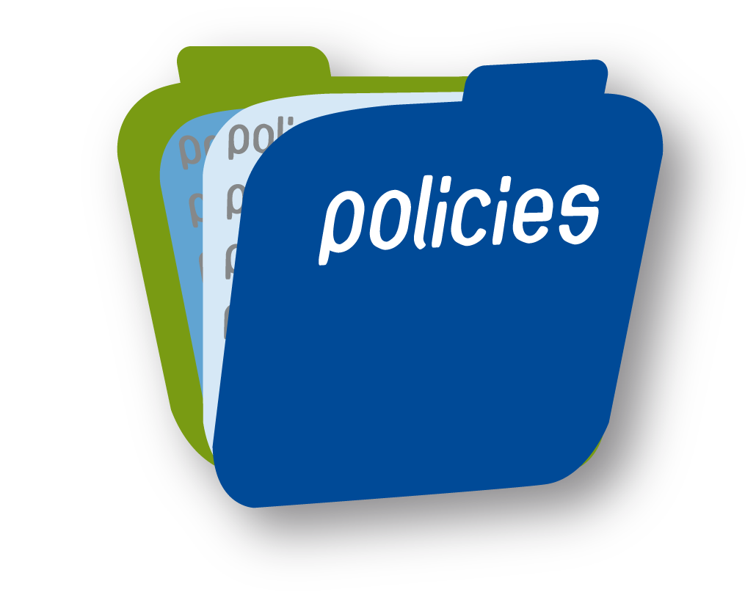
Policy – Plan, Measure, Monitor
Decide what you’re going to allow and create specific policy
Measure / monitor
Flag violations as errors (policy enforcement)
Notes:
If you don’t have an actual policy, then your operating policy is probably not what you intended. For example, if you decide that people should perform unit testing, and you tell them they should, but don’t have any actual measurement or control on the system, then the policy is really “ you can do unit testing if you want” or even “ we want you do do unit testing, but you don’t actually have to.
Policy needs to be backed up by the development testing infrastructure. If you have a security policy that specifies things like use of encryption, input validation, etc. it should be connected to your static analysis and unit test, so that the policy becomes more than just a piece of paper, but something actionable.
Then you can measure, monitor, and have assurance that the policy is indeed being followed. In many industries such as FDA this is a requirement. If you have traceability needs, this is crucial.
Another thing to remember is that if you’re finding issues in QA or test that are covered by your policy and should be caught during development, then you have another problem. Anything that makes it through to QA is really either a process problem, a missing policy, or an unenforced policy.

Slide 15
Questions
info@parasoft.com webinar@parasoft.com
Notes:
You mentioned policy at the end – but how does it really affect me? Can’t I just create what I need and put it out there?
I the cloud we may not have access to Event View or even HDD (for writing files). Any suggestions on best practices to log/transport exception data for developer’s consumption when working in the cloud. Log to SQL, log files if available, etc?
All the practice you mention are well-known and generally ignored. Do you think migrating to the cloud will be better motivator for good practices?
What is the reliability of moving database server ( database) into a cloud environment from a dedicated server. Is there any risk (security, data loss, etc)?
-- from me –
Isn’t it easier/safer to just virtualize my existing application through a cloud provider?
How can static analysis help me prepare for cloud deployment?

